Slide 1

Case Manager Orientation
2026

Slide 2
Welcome to Orientation.
To complete this orientation and receive your login credentials to refer clients to Flourish please review this slideshow.
After reviewing the slideshow, you will need to downlaod a test here:
Case-Manager-Orientation-Quiz-January-2024-Fillable-1.pdf
Email completed test to ClientServices@Flourishfurniturebank.org.
Upon passing the test, login credentials will be created and emailed to you.
This new process has been created to ensure case managers are able to access orientation on their schedule and to streamline the process.
DO NOT SHARE YOUR LOGIN CREDENTIALS!
Case Manager Orientation
2026

Slide 3
Our History
Flourish Furniture Bank has its origins in 2009 as “My Father’s House,” a ministry of United Methodist Church of the Resurrection.
The founder, a former HUD employee, recognized that many people were living in unfurnished homes and began collecting donated furniture and home essentials to serve as a community resource.
As the ministry grew, it developed community partnerships and a dedicated volunteer base, allowing us to serve more and more guests each year.
The organization rebranded as Flourish Furnishings, Inc. (Flourish).
Flourish became a 501c3 non-profit organization in November 2019.

Slide 4
Where Compassion
Meets Sustainability
In 2025, Flourish served 1,320 families with plans to serve 1,500 in 2026.
Flourish partners with over 90 social service agencies for referrals. These organizations serve individuals that have experienced housing instability due to domestic violence, aging out of foster care, immigration/refugee status, re-entry from incarceration, natural disaster, job loss, and more. List here: https://flourishfurniturebank.org/if-you-need-furnishings/
Flourish leans heavily on volunteers with over 1,000 unique volunteers serving over 30,000 hours annually.
Over 83,000 items were provided to families and were kept from entering a landfill.

Slide 5

The best way to understand the process and help your guest prepare for success, is to
come out for a tour!
Every visitor to our warehouse is surprised by all the things that go into preparing items for our guests and all the care that is offered.
It’s also a great time for us to discuss ways we can deepen our partnership between Flourish and your agency and helps us to get to know you, too!

Slide 6
Qualifying for An Appointment
Every famility that comes to Flourish must come through a referral by a case manager at one of our Referring Partner Agencies.
Individuals may only visit Flourish ONCE for an appointment. We have this guideline in order to serve as many families who have a need for an entire home of furniture and essentials.
Families visiting Flourish should have a need for an entire home of furniture and essentials. We cannot offer appointments for families that only need a few items. (example: just needs a bed or sofa)
In order to ensure individuals can make the most of this once in a lifetime opportunity, we partner with organizations like yours to ensure you are supporting them with all their needs, to ensure they are able to retain the items provided by Flourish.
Before scheduling an appointment for an individual or family, you should ask them if they have visited Flourish before.
If they HAVE been to Flourish in the past, please do not schedule an appointment. If you feel the family would qualify for an exception to the one-visit rule, please submit your request for an exception to Amy Cox, Executive Director at Amy@FlourishFurnitureBank.org. Do not schedule an appointment without receiving permission for a return visit.

Slide 7
Preparing for An Appointment
To best prepare an individual for an appointment, you must work WITH them to fill out the Preference Sheet and the Guest Checklist prior to the appointment.
The Preference Sheet and Checklist are found here: https://flourishfurniturebank.org/for-case-managers/
Please download forms each time so you are sure it is the most current version as we make updates.
Preference Sheets and Checklists MUST be received by Flourish at clientservices@flourishfurniturebank.org 48 hours prior to the appointment and must be signed by guest and case manager.
Flourish does not require case managers to attend appointments. We encourage case managers to attend, when able. We ask that you take your client's needs into consideration and accompany them, as needed.
Case managers MUST help the client (our guest) with transportation for their appointment. Even if the client is paying for this, support in ensuring their success in securing transport is necessary. More information on Flourish Delivery is provided later in this training.

Slide 8
Communications and Forms
All forms and communications should be sent to the following email address:
ClientServices@Flourishfurniturebank.org
Appointment Types
In-Person Shopping – Flourish now only offers in-person appointments, as we want everyone to personally choose their furnishings. Our volunteers greet guests in the parking lot, assist with furniture selection in the warehouse, then load furniture and other items onto the guest's truck.
If an in-person appointment is a barrier for your client (our guest), please reach out to us at ClientServices@Flourishfurniturebank.org and we can consider an alternative.

Slide 9
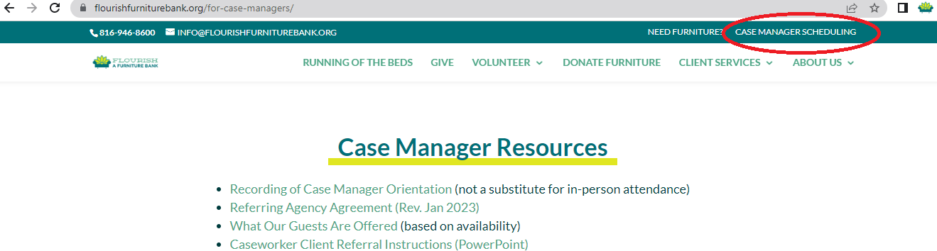
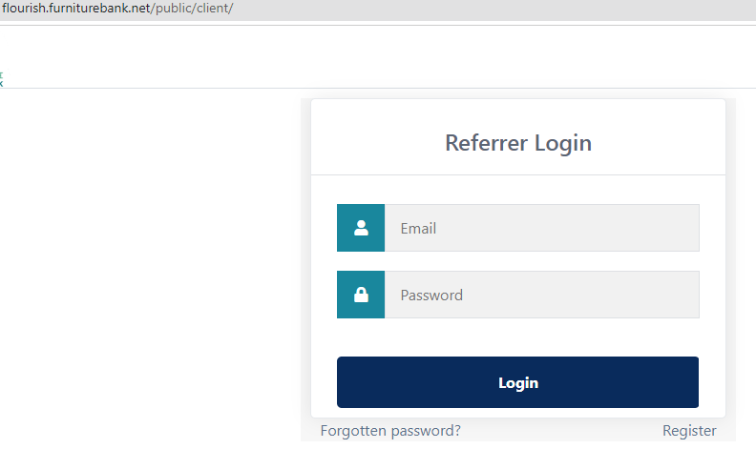
To schedule an appointment
Start by going to Flourishfurniturebank.org and go to the upper right corner to Case Manager Scheduling.
2. Use your credentials to login to Furniturebank.net --
DO NOT SHARE YOUR CREDENTIALS.

Slide 10
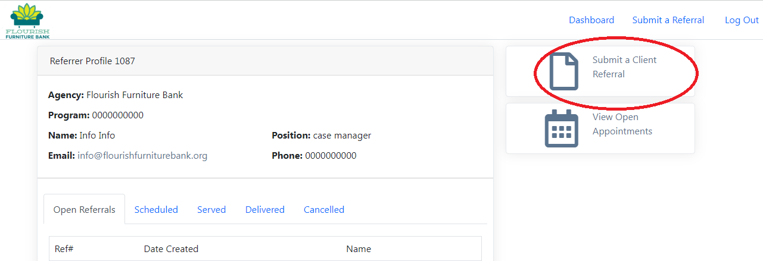
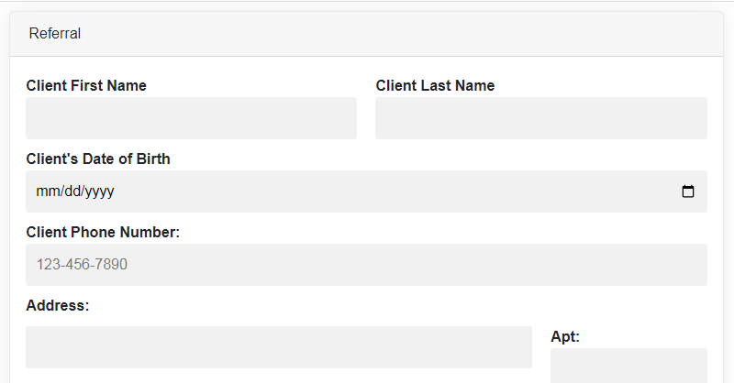
Scheduling an Appointment, Cont..
​
3. Choose Submit a Client Referral (Or you can look at the calendar of available appointments first.)
3. Move through the screens of Client Information.
Be sure to fill out ALL information.

Slide 11
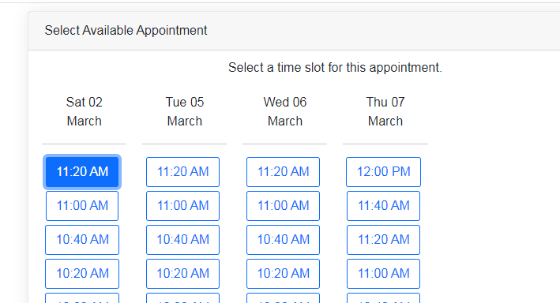
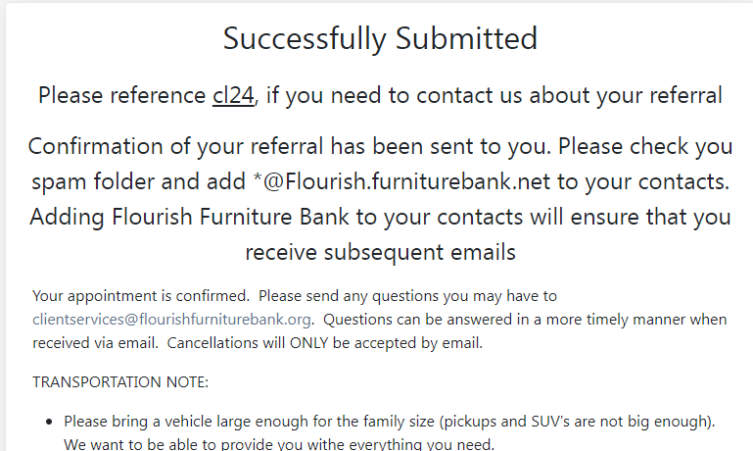
4. Choose an appointment date and time.
5. When submitted successfully, you will see a confirmation screen.

Slide 12
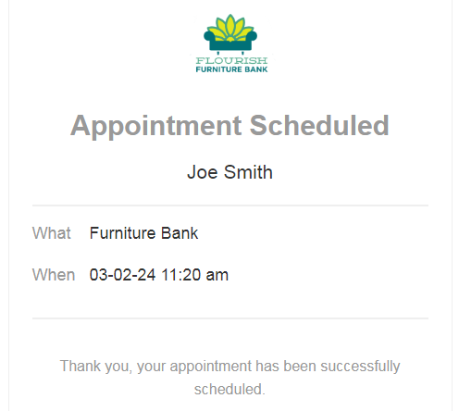
6. You will receive a confirmation email.
Prior to appointments, volunteers also make reminder calls. Please be sure you respond to calls and texts in a timely manner.
7. Click on your Dashboard to see a list of all of your Scheduled, Completed or Cancelled appointments.

Slide 13
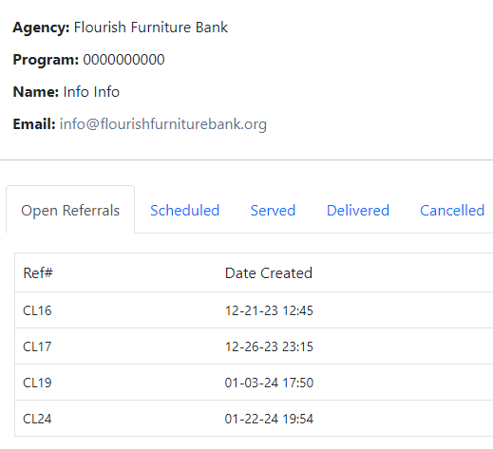
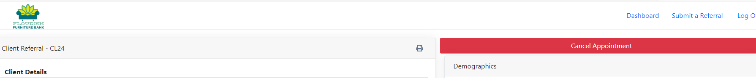
To CANCEL an appointment
All appointments need to be cancelled AT LEAST 24 hours in advance. Failure to do so will result in being charged for the appointment.
Appointments cannot be cancelled over the phone or email.
Log into your account. Go to your Scheduled Appointments and choose the appointment you would like to cancel.
Look in the upper right corner for the cancel button.
If you need to re-schedule, a Schedule Appointment button will appear after you have completed the cancellation.

Slide 14
  Flourish Furniture Delivery Option
Flourish offers a limited delivery service option. This option is a door-to-door delivery. We CANNOT move furniture into the home.
Flourish offers this service on a very limited basis when the agency or family cannot find another delivery source. We are typically able to offer delivery for 2 appointments per week.
The case manager must be at the delivery location at the time of the delivery.
The partner agency will be charged a $200 delivery charge plus the appointment referral fee. This will be billed monthly with the rest of their agency appointments.
A delivery waiver must be signed and submitted to reserve a delivery.
To access delivery services, please view the Flourish Delivery Program Overview and Flourish Delivery Program Waiver under Case Manager Resources on our webpage.
​

Slide 15
Please email ClientServices@Flourishfurniturebank.org
with any questions.

Slide 16
Steps to Ensure a Successful Appointment
Walk through the Preference Sheet with your client. Help them think through the things they will need, the size of their new living space, and their preferences. The more they think through these things, with your support, ahead of time, the more successful their appointment will be.
Walk through the Guest Checklist with them. Have them initial each entry and make sure you both sign the document. This is VERY important. This checklist was created to ensure that every guest knows where to be, when to arrive, what to bring, and what to expect.
Help your client secure a moving truck! This looks different for each of our partners. Some agencies have their own truck or are able to hire a truck and/or movers. Other agencies do not have the funding for either. Whatever your situation, your client needs your help to ensure their success in securing a vehicle. Our number one reason for missed appointments is not having the proper vehicle secured. PLEASE PICK UP THE MOVING TRUCK THE NIGHT BEFORE THE APPOINTMENT TO ENSURE THE VEHICLE IS AVAILABLE, EVEN IF YOU HAVE A RESERVATION.
Remember that others are also in need of appointments. If, for whatever reason, your client cannot use the appointment you secured for them, you MUST cancel at LEAST 24 hours in advance. This gives someone else a chance to secure an appointment. Please be courteous.

Slide 17
Email confirmation will be sent. Please check your spam folder.
All appointments are also listed in your account.

Slide 18
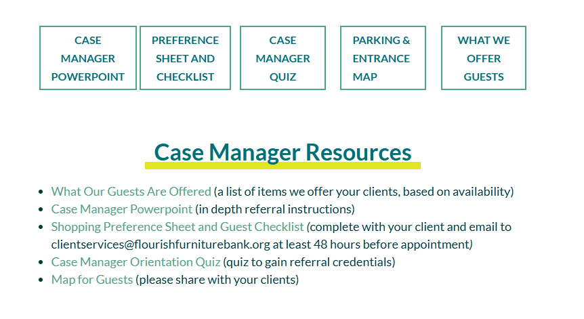
Case manager resources including Preference Sheet, Guest Checklist, What Guests are Offered, and more can be found at the Case Manager Resources page on our website.

Slide 19
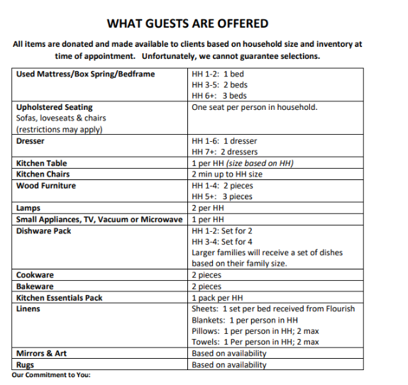
All items are based on family size and inventory.

Slide 20
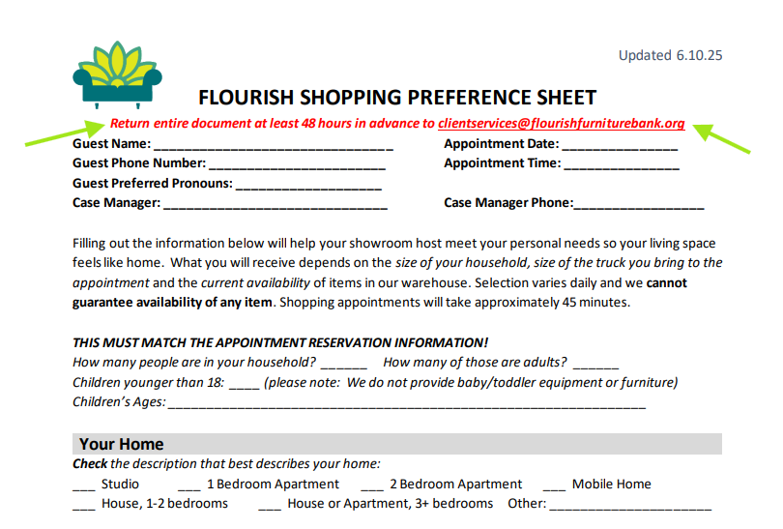

Slide 21
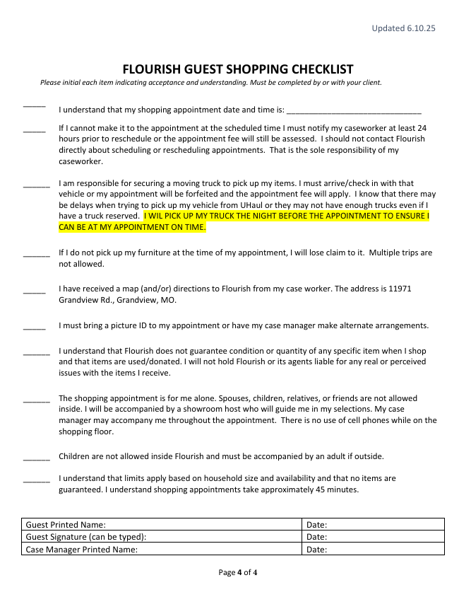
Please review all items on the checklist.
Checklist needs to be signed by case manager and guest.
Case manager should fill out Preference Sheet and Checklist WITH their client.

Slide 22
Appointment Reminders
It is the case manager's responsibility to support their client in arranging to have a U-Haul or other moving truck to transport their items. Smaller vehicles limit the number and size of items we can provide. Please do not send your client in a small pickup truck or SUV. Flourish provides our guests with an ENTIRE moving truck of items and they can only take advantage of this once in a lifetime. This is important!
Guests should arrive 15 minutes before their appointment time with their photo ID. It is a good idea to have an extra copy of their signed checklist and their completed preference sheet.
Please sure to send the Shopping Preference Sheet 48 hours in advance to clientservices@flourishfurniturebank.org
Our address is 11971 Grandview Rd, Suite A, facing the fireworks building. Guests can park in front of the Glass Showroom Doors that say "GUEST ENTRANCE." We have reserved parking spaces for them. Moving Trucks must park alongside the Fireworks Building in the reserved spaces. Driving directions are available on our website.
All appointments require all items to be removed from the premises at the time of the appointment. Due to space limitations, we do not have staging space to store items and do not allow multiple trips. Please plan accordingly and bring a moving truck!
We are excited to have your client as our guest. We want to make them feel at home and let them know that the community cares about them and believes they should live in a dignified manner in a home full of furniture and home essentials they have been able to choose. Thank you for supporting us in our mission to serve Kansas City!

Slide 23
FEES: Your organization will be invoiced monthly, net 30 days.
Under no circumstances should you ask your client to pay us directly.
Our partnership is with you, not your client (our guest).
Flourish does not accept any payments on-site.
All appointments are the responsibility of the scheduling agency. Any appointments not cancelled AT LEAST 24 hours in advance will incur a full charge for that appointment time.
If you do not cancel your appointment in an appropriate amount of time, another family misses their opportunity to take that appointment time.
You can reschedule an appointment but will be charged a second fee, if the appointment was not cancelled in time.

Slide 24

Send us furniture donations
As a part of your partnership agreement, please send individuals who may reach out to you with furniture donations to us.
By repairing, restoring and housing furniture for all, we can ensure your guests have an abundance from which to choose for their appointment.
Flourish is 100% donation based using home pickups, corporate partnerships, and community drives to fill our warehouse.
Find out more at:
https://flourishfurniturebank.org/donatefurniture/

Slide 25
To Receive Your Credentials
1. Go to Client Services Tab on Flourishfurniturebank.org
2. Choose For Case Managers Tab
3. Download and complete Case Manager Orientation Quiz.
4. Email test to ClientServices@Flourishfurniturebank.org
5. Ask your supervisor to email clientservices@flourishfurniturebank.org giving permission for you to be added as a referrer for your agency.
5. Upon passing the test and receiving approval from your supervisor, your credentials will be emailed to you. Please check your spam folder.
6. Add *@flourish.furniturebank.net to your address book to ensure you will receive emails.
Always use ClientServices@Flourishfurniturebank.org as your resource email for questions, forms and more!

Slide 26
Take a Flourish Tour!!!
Please email us to set up a tour! Having a tour of Flourish before referring clients really helps you understand the flow and process. Plus, we just really want to meet you!
You will get to visit the showroom where your clients will shop plus see all of our prep areas like our woodworking department, sewing department, and more!
Email us at ClientServices@FlourishFurnitureBank.org to set up!

